Slide 1

INNOVATIVE IDEA
Innovative idea
Innovative idea

Slide 2

Zero-Energy House
*Imagine a fully functional house that requires net zero electricity and in turn, stores energy for future use. A group of about 70 engineering and architecture students from Indian Institute of Technology (IIT) Bombay have designed exactly this.
** The brainchild of team SHUNYA or ‘Sustainable Habitat for an Urbanizing Nation by its Young Aspirants’, Project Solarise’ is a 2,000 sq ft solar-powered villa that comprises three well-furnished rooms along with a kitchen that is amply lit and air-conditioned.

Slide 3

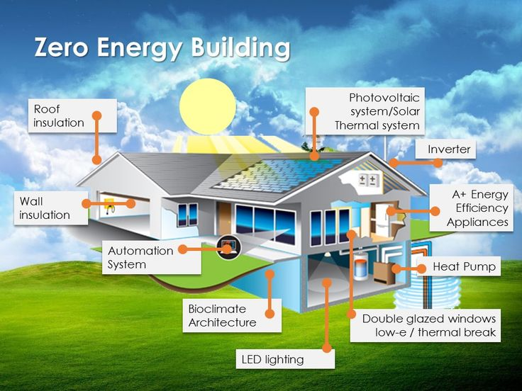
***The energy supply for the house is generated on its rooftop through solar panels, which has the added ability to route excess energy generated on sunny days to a power grid. Not limited just to the house, even the appliances (oven, cooker, etc.) in this fully functional house are powered by solar energy.

Slide 4

Thank you….

